Slide 1



Randomized Algorithm for Probabilistic Route Optimization under Uncertainty
Improving route selection reliability through stochastic simulation and probabilistic reasoning

Slide 2
Project Context and Motivation
The Challenge
Our Objective
Real-world traffic systems face unpredictable variability—congestion patterns shift, accidents occur randomly, and weather conditions change rapidly. Traditional deterministic routing algorithms fail to account for these uncertainties, leading to unreliable predictions and suboptimal route choices.
Enhance route optimization performance by introducing randomized algorithms that explicitly model uncertainty. Building upon our deterministic simulation framework from Milestone 3, we now incorporate probabilistic reasoning to maximize on-time arrival probability rather than minimizing expected travel time.

Slide 3




Deterministic Baseline Overview
Fixed Decision Rule
Standard Algorithms
Same input produces identical output every time—no consideration of variability or randomness in travel conditions
Uses A*(star) shortest-path algorithms that minimize expected travel time without uncertainty modeling
Strengths
Limitations
Simplicity, computational efficiency, predictability, and ease of implementation in stable environments
Poor handling of uncertainty, suboptimal performance in dynamic environments, unreliable predictions under variability

Slide 4





System Pipeline Overview
Input
Network topology, origin-destination pairs, travel time distributions
Traffic Simulation
Stochastic travel time generation based on probability distributions
Decision Rule
Randomized probabilistic route selection (modified component)
Route Selection
Optimal path based on on-time arrival probability
Output
Selected route with reliability metrics
Only the decision logic component is modified in this milestone, maintaining compatibility with existing simulation infrastructure while introducing probabilistic reasoning capabilities.

Slide 5
Sources of Uncertainty
Traffic Congestion Variability
Random Delays
Road Accidents
Peak hours, special events, and random fluctuations cause unpredictable delays
Unexpected slowdowns from merging traffic, construction zones, or incidents
Unpredictable collisions and emergencies blocking lanes temporarily
Weather Conditions
Data Uncertainty
Rain, fog, snow reduce speeds and increase travel time variability
Incomplete or noisy travel time measurements in historical data
Deterministic decisions fail under these conditions because they assume perfect knowledge of future travel times, ignoring the inherent randomness in real-world transportation systems.

Slide 6
Random Variables in the System
01
02
03
Segment Travel Time
Route Aggregation
Arrival Time
Each road segment has travel time modeled as a random variable with known distribution
Total route travel time computed as sum of segment times along the path
Arrival time relative to deadline determines success probability
Distribution Assumptions
Gamma Distribution
Log-Normal Distribution
Models skewed delay patterns with positive support and flexible shape parameters
Ensures positive travel times while capturing multiplicative variability
Mean and variance parameters estimated from historical data, assuming independence between segments for computational tractability.

Slide 7




Randomized Algorithm Design
Core Objective
Select Route
Maximize probability of on-time arrival rather than minimize expected travel time. This shift in optimization goal fundamentally changes how routes are evaluated and selected.
Identify candidate path in network
Sample Travel Times
Monte Carlo Simulation
Introduces randomness through repeated sampling from travel time distributions, building empirical probability estimates for each candidate route.
Draw from segment distributions
Compute Total Time
Sum segment times for route
Repeat Simulation
~1000 runs per route

Slide 8
Probabilistic Reasoning Framework
Optimization Target
Maximize P(T <=Deadline) for total travel time T
Probability Density Function (PDF)
Cumulative Distribution Function (CDF)
Theoretical Bounds
Chebyshev's inequality and Markov bound provide conservative estimates without full distribution knowledge
Characterizes likelihood of specific travel times, showing concentration of probability mass
Gives on-time arrival probability directly—primary metric for route comparison and selection
Probabilistic decisions outperform deterministic ones because they explicitly account for variability, choosing routes with higher reliability rather than shorter expected duration.

Slide 9
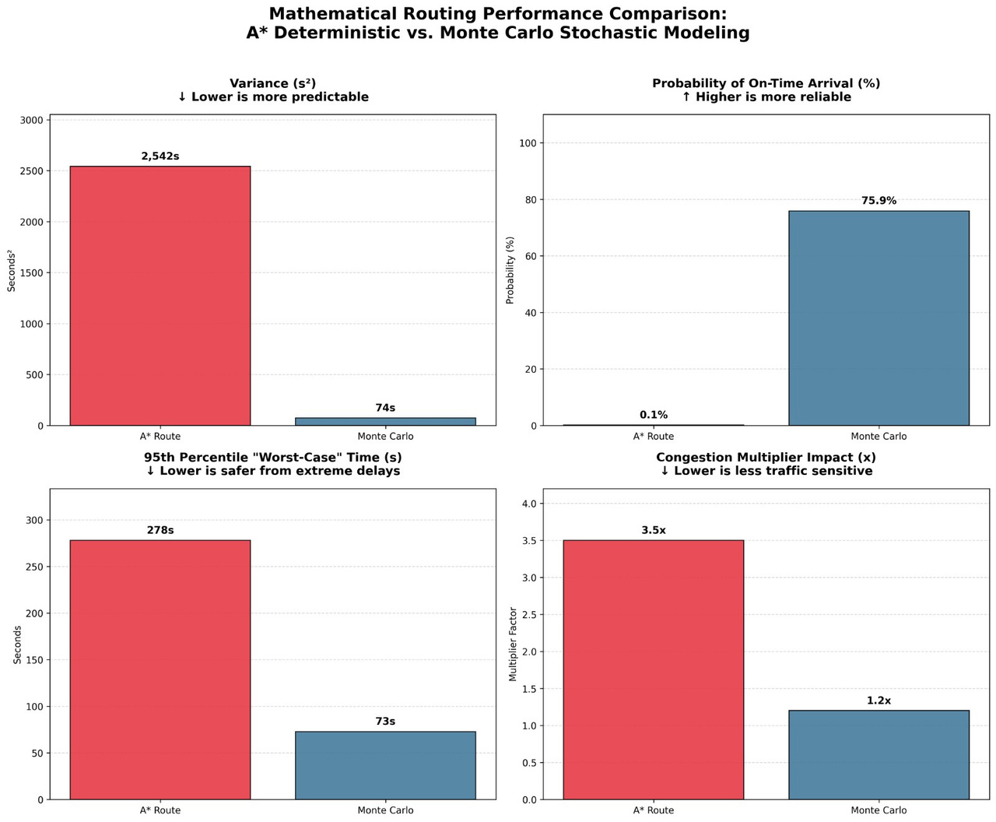
Implementation and Evaluation
Integration Approach
Embedded Monte Carlo simulation within existing traffic simulation pipeline, maintaining compatibility with SUMO. Approximately 1000 simulation runs per route provide stable probability estimates.
Evaluation Metrics
On-time arrival probability (primary)
Average travel time
Variance and standard deviation
Delay probability
Robustness under uncertainty

Slide 10
Results and Key Insights
Comparative Performance
↑
↑
↑
~
Reliability
Robustness
Flexibility
Computation
Higher on-time arrival probability across varied conditions
Better handling of uncertainty and variability
Adapts to changing conditions through sampling
Trade-off: higher cost vs. accuracy
Conclusion
Randomized strategies consistently outperform deterministic baseline in uncertain environments. Monte Carlo simulation proves effective for probabilistic route optimization, with improvements in reliability justifying increased computational expense.

